Slide 1
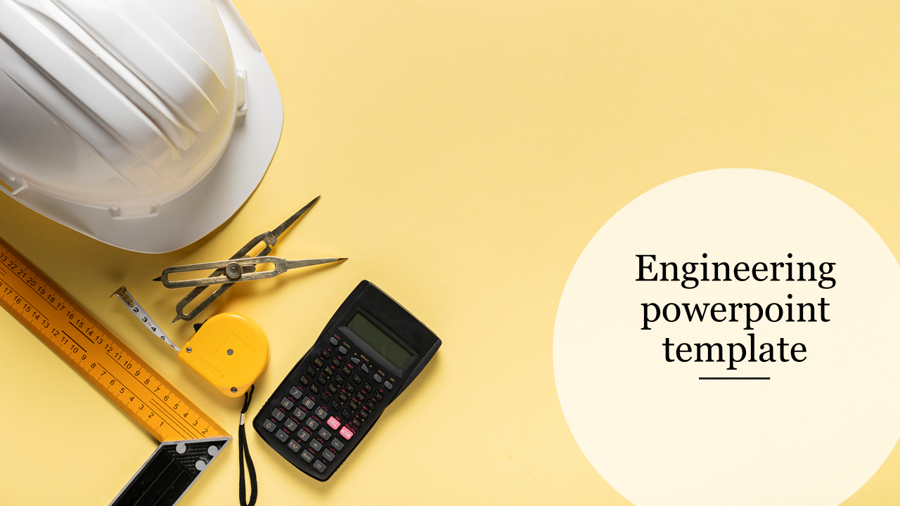
ENGINEERING GRAPHICS
ENGINEERING GRAPHICS
Projections of points and lines
Presented
BY:
☺ BY ☺

Slide 2
POINTS
Above HP
Infront of HP
Behind VP
VP
HP
X
Y
REFERENCE LINE
Below HP
Behind HP
Infront of VP
HP - a’
VP - a

Slide 3
1. A 20 mm above HP and 15 mm in front of VP
2. B 20 mm below HP and 30 mm behind VP
3. C 10 mm infront of HP and 35 mm behind VP
4. D 10 mm behind HP and 20 mm in front of VP
c
b
a’
35
30
c’
20
VP
HP
10
X
Y
15
20
10
20
d’
a
b’
d
ALL DIMENSIONS ARE IN mm

Slide 4
Straight Lines
el
Lines || to both HP and VP.
Lines to one plane & || to another plane.
Lines inclined to one plane and || to another plane.
Lines inclined to both the plane.
r
el
el
HP points a’
Front view
VP
X
Y
Top view
HP
VP points a

Slide 5
X
Y
Parallel to HP & VP
Perpendicular to HP
&
Parallel to VP
VP
HP
VP
Parallel to HP
&
Perpendicular to VP
HP

Slide 6
1.Lines parallel to both HP & VP:
A Line CD 30mm long is parallel to both planes. The line C is 40mm above the HP and 25mm in front of the VP. Draw its projections
c’
d’
Locus of c’
30
40
VP
HP
X
Y
25
30
Locus of c
c
d
True Length = 30mm
HP = 40mm
VP = 25mm
ALL DIMENSIONS ARE IN mm

Slide 7
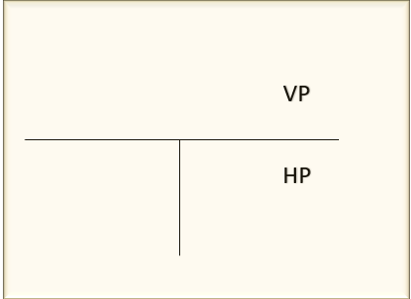
2.Lines perpendicular to one plane, parallel to another plane
a) parallel to HP , perpendicular to VP.
A line GH, 50mm long has its end G 20mm above HP and 25mm in front of VP. The line is kept perpendicular to VP and
parallel to HP. Draw its projections.
T L = 50mm
HP = 20mm
VP = 25mm
g’
Locus of g’
20
VP
HP
X
Y
25
Locus of g
g
50
Locus of h
h
ALL DIMENSIONS ARE IN mm

Slide 8
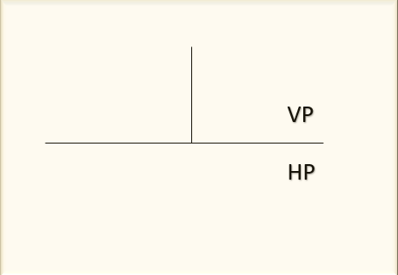
b) Parallel to VP & perpendicular to HP:
A line EF 55mm long has its end E 15mm above HP and 25mm in front of VP. The line is kept perpendicular to HP and
parallel to VP. Draw its projections.
f’
Locus of f’
T L = 55mm
HP = 15mm
VP = 25mm
55
e’
Locus of e’
15
VP
HP
X
Y
25
e
Locus of e
ALL DIMENSIONS ARE IN mm

Slide 9
3.Lines inclined to one plane, parallel to another plane
a) Inclined to HP, Parallel to VP:
A line PQ 50mm long has its end P 30mm above HP and 25mm in front of VP. The line is kept inclined at 40˚ to HP and
parallel to VP. Draw its projections.
q’
55
p’
40˚
Locus of p’
30
VP
HP
X
Y
25
Locus of p
p
q
T L = 55mm
HP = 30mm
VP = 25mm
p’q’ = Front view
Pq = Top view
ALL DIMENSIONS ARE IN mm

Slide 10
b) Inclined to VP, Parallel to HP
A line PQ 50mm long has its end P 25mm above HP and 25mm in front of VP. The line is inclined at 45˚ to VP and parallel to HP. Draw its projections
p’
q’
Locus of p’
25
VP
HP
X
Y
25
Locus of p
p
45˚
50
q
T L = 50mm
HP = 25mm
VP = 25mm
p’q’ = Front view
Pq = Top view
ALL DIMENSIONS ARE IN mm

Slide 11
st
nd
1
2
End Projector
No End Projector

Slide 12
4. Lines inclined to both planes:
a)
A line PQ 70mm long has one end 15mm above HP and 30mm in front of VP. The line is inclined at 35˚ to HP and 45˚
to VP. Draw its projections of the line
q2’
q’
Locus of q’
p’
70
35˚
Locus of p’
q1’
15
VP
HP
X
Y
30
q1
Locus of p
T L = 70mm
HP = 15mm
VP = 30mm
p
45˚
70
p’q2’ = Front view
Pq2 = Top view
Locus of q
q2
q
ALL DIMENSIONS ARE IN mm

Slide 13
b)
The line PQ 80mm long has its end R 20mm above HP and 30mm in front of VP. The TV and FV are 50mm & 65mm. Draw its projections.
q2’
q’
Locus of q’
p’
80
q1’
Locus of p’
20
65
VP
HP
X
Y
30
50
T L = 80mm
HP = 20mm
VP = 30mm
q1
Locus of p
p
80
Locus of q
p’q2’ = Front view
Pq2 = Top view
q
q2
ALL DIMENSIONS ARE IN mm

Slide 14
c)
End P of line PQ is 10mm above HP and 20mm in front of VP. The other end is 45mm above HP and 65mm in front of VP. The distance between the end projector is 40mm. Draw the projection and find inclinations and true length.
q’
q2’
Locus of q’
45
q1’
Locus of p’
p’
10
VP
HP
X
Y
20
40
p
Locus of p
65
q1
Locus of q
p’q’ = Front view
Pq = Top view
q
q2
ALL DIMENSIONS ARE IN mm

